Slide 1
C4 Diagrams
Team 2

Slide 2
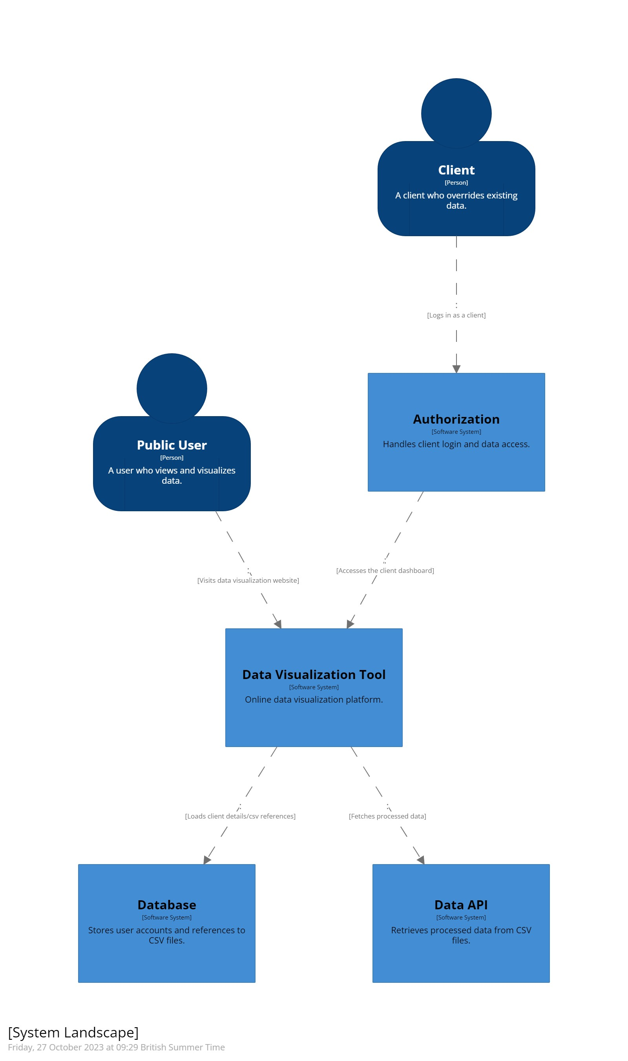
Context

Slide 3
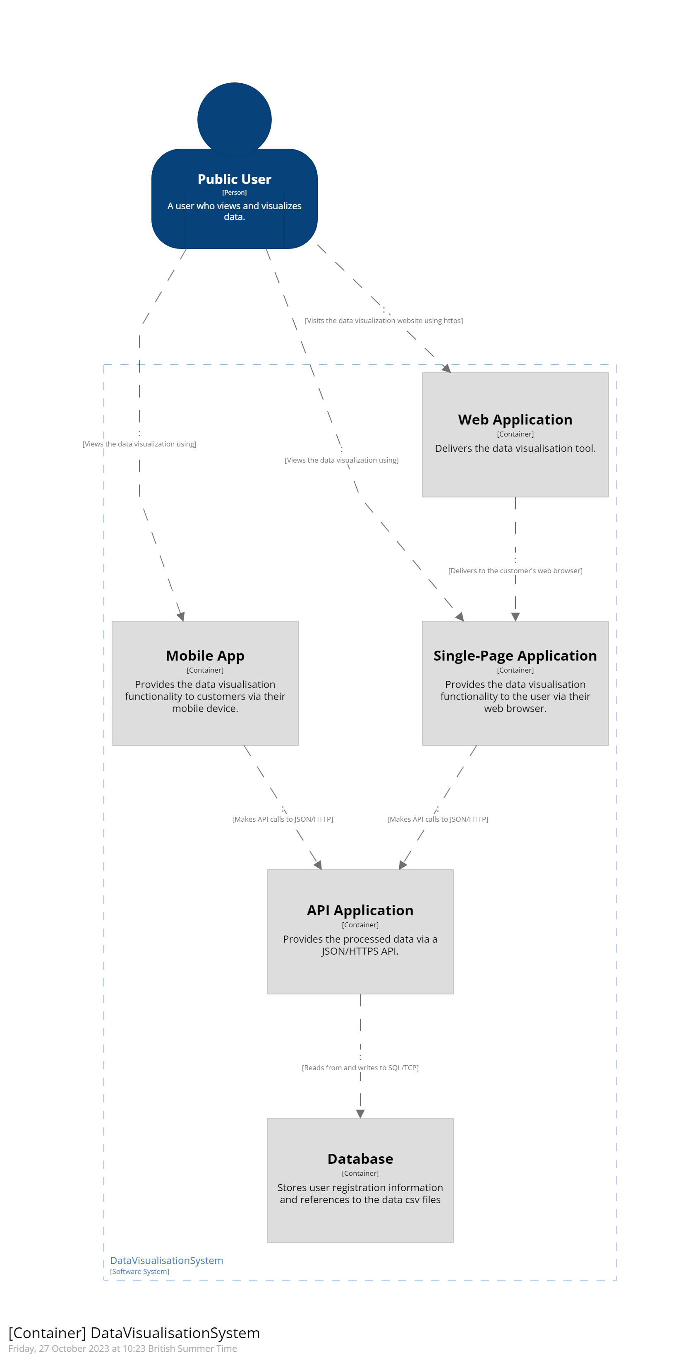
Container

